Slide 1
Simplex Algorithm

Slide 2
General Steps of Simplex Method
Step 1. Suppose an initial simplex form at hand
Step 2. Select a non-basic variable that will become basic
  With negative coefficient on row 0
  The most negative one will be chosen if there are multiple choices
  Referred to as the pivot column
Step 3. Choose a basic variable that will become non-basic
  To be discussed in the next slide
  Referred to as the pivot row
Step 4. Move to the next simplex form or BFS
Step 5. Test if the new BFS is optimal. If not, go to Step 2.

Slide 3
Choose the Pivot Row
Recall that the pivot column is selected
  Suppose it is column s (variable x_{s} becomes basic)
For each row i, if the element at the column s, denoted by a_{is}, is positive,
  Calculate the ratio b_{i}/ a_{is}, where b_{i} is the right-hand-side of row i.
  Choose the row with the minimum ratio as the pivot row.
This is known as the minimum ratio test
  The purpose is to guarantee the feasibility of the new BFS by determining how large the variable x_{s} can increase from 0
Special case
  If no positive a_{is} can be found, x_{s} can be increased arbitrarily large, implying the problem is unbounded.

Slide 4
Example of Simplex Method
 |  | Coefficients
Row | Basic | z | x₁ | x₂ | x₃ | x₄ | x₅ | RHS | ratio
0 | Z | 1 | -2 | -3 | 0 | 0 | 0 | 0 | -
1 | x₃ | 0 | -1 | 1 | 1 | 0 | 0 | 5 | 5(=5/1)
2 | x₄ | 0 | 1 | 3 | 0 | 1 | 0 | 35 | 11.67(=35/3)
3 | x₅ | 0 | 1 | 0 | 0 | 0 | 1 | 20 | -
Step 2. Most negative coefficient
Step 3. Minimum ratio
Row | Basic | z | x₁ | x₂ | x₃ | x₄ | x₅ | RHS | ratio
0 | Z | 1 | -5 | 0 | 3 | 0 | 0 | 15 | -
1 | x₂ | 0 | -1 | 1 | 1 | 0 | 0 | 5 | -
2 | x₄ | 0 | 4 | 0 | -3 | 1 | 0 | 20 | 5(=20/4)
3 | x₅ | 0 | 1 | 0 | 0 | 0 | 1 | 20 | 20=(20/1)

Slide 5
Simplex Method Continues
Row | Basic | z | x₁ | x₂ | x₃ | x₄ | x₅ | RHS | ratio
0 | Z | 1 | -5 | 0 | 3 | 0 | 0 | 15 | -
1 | x₂ | 0 | -1 | 1 | 1 | 0 | 0 | 5 | -
2 | x₄ | 0 | 4 | 0 | -3 | 1 | 0 | 20 | 5(=20/4)
3 | x₅ | 0 | 1 | 0 | 0 | 0 | 1 | 20 | 20=(20/1)
Row | Basic | z | x₁ | x₂ | x₃ | x₄ | x₅ | RHS | ratio
0 | Z | 1 | 0 | 0 | -0.75 | 1.25 | 0 | 40 | -
1 | x₂ | 0 | 0 | 1 | 0.25 | 0.25 | 0 | 10 | 40
2 | x₁ | 0 | 1 | 0 | -0.75 | 0.25 | 0 | 5 | -
3 | x₅ | 0 | 0 | 0 | 0.75 | -0.25 | 1 | 15 | 20
Step 2. Most negative coefficient
Step 3. Minimum ratio

Slide 6
Simplex Method Continues
Row | Basic | z | x₁ | x₂ | x₃ | x₄ | x₅ | RHS | ratio
0 | Z | 1 | 0 | 0 | -0.75 | 1.25 | 0 | 40 | -
1 | x₂ | 0 | 0 | 1 | 0.25 | 0.25 | 0 | 10 | 40
2 | x₁ | 0 | 1 | 0 | -0.75 | 0.25 | 0 | 5 | -
3 | x₅ | 0 | 0 | 0 | 0.75 | -0.25 | 1 | 15 | 20
Row | Basic | z | x₁ | x₂ | x₃ | x₄ | x₅ | RHS | ratio
0 | Z | 1 | 0 | 0 | 0 | 1 | 1 | 55
1 | x₂ | 0 | 0 | 1 | 0 | 0.33 | -0.33 | 5
2 | x₁ | 0 | 1 | 0 | 0 | 0 | 1 | 20
3 | x₃ | 0 | 0 | 0 | 1 | -0.33 | 1.33 | 20
No negative coefficient in row 0: Optimal solution is found. What is it?

Slide 7
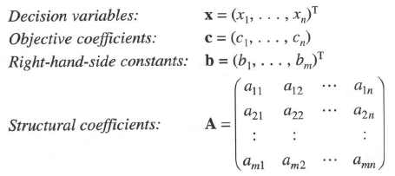

Review: Simplex Method Using Matrix Notation
Maximize问题

Slide 8
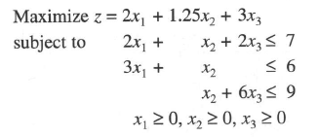
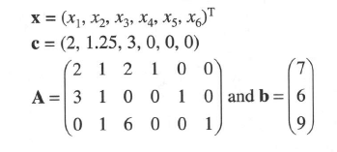
Example
定义x₄,x₅,x₆为松弛变量(slacks), 我们可以得到

Slide 9
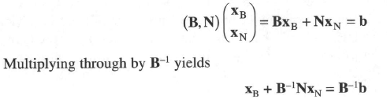

Suppose we now assume that the n variables are permuted so that the basic variables are the first m components of X.
Then, we can write X = (X_{B}, X_{N}), where X_{B} and X_{N} refer to the basic and non-basic variables.
The matrix A can also be partitioned similarly into A = (B, N), where B is the m*m basis matrix and N is m*(n-m).
The equation AX=b can thus be written as:
Thus, we have

Slide 10



The objective function can be written as the sum of two terms, one for the basic variables and the other for the non-basic variables:
A basic solution is found by setting the non-basic variables equal to zero, i.e., X_{N}=0, so we have
We define , ,which is dual variable(对偶变量值) or called shadow price(影子价格).

Slide 11
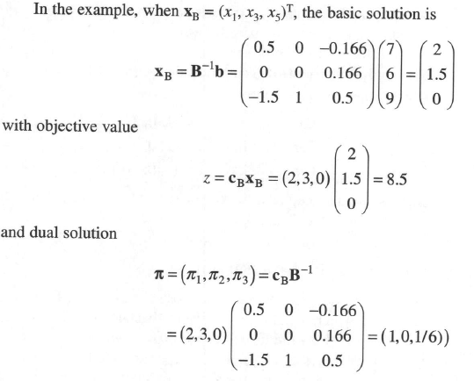

Slide 12


How to determine if a particular basic solution is optimal?
  We have
  When the non-basic variables are set to zero, the objective value for the basic solution is z = c_{B}B⁻¹b.
  Now we want to hold all the non-negative variables to zero except x_{k}, and observe the effect.
  The column for x_{k} in N is the same as the column for x_{k} in A; call it A_{k}. The resulting objective function is:

Slide 13


We define, for the general non-basic variable x_{k}, the marginal change
A sufficient condition for a given basis to be optimal is that increasing any non-basic variable will cause the objective to decrease or stay the same. Mathematically, the basic solution is optimal if:
where Q is the set of non-basic variables.
If this condition is not satisfied, every non-basic variable with a negative marginal value is a candidate for entry into the basis.

Slide 14
Revised Simplex Algorithm

Slide 15
The Revised Simplex Algorithm
Notations
  BV = any set of basic variables (基变量)
  b = right-hand-side vector of the original tableau’s constraints
  a_{j} = column for x_{j} in the constraints of the original problem
  B = m*m matrix whose j-th column is the column for BV_{j} in the original constraints
  c_{j} = coefficient of x_{j} in the objective function
  c_{BV} = 1*m row vector whose j-th element is the objective function coefficient for BV_{j}
  u_{i} = m*1 column vector with i-th element 1 and all other elements equal to zero.

Slide 16
In the tableau for any set of basic variables BV:
  B⁻¹a_{j} = column for x_{j} in BV tableau
  c_{BV}B⁻¹a_{j} – c_{j} = coefficient of x_{j} in row 0
  B⁻¹b = right-hand side of constraints in BV tableau
  c_{BV}B⁻¹u_{i} = coefficient of slack variable s_{i} in BV in row 0
  c_{BV}B⁻¹b = right-hand side of BV in row 0
If we know BV, B⁻¹, and the original tableau, the above formulas enable us to compute any part of the simplex tableau for any set of basic variables BV.

Slide 17
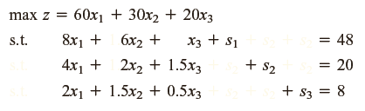
Example
B⁻¹ for the current tableau will simply be the 3*3 matrix
Whose j-th column is the column for s_{j} in the current tableau.
For the original tableau BV(0), the set of basic variables is
given by:
基变量 BV(0) = {s₁, s₂, s₃}
非基变量 NBV(0) = {x₁, x₂, x₃}

Slide 18
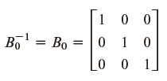

We let B_{i} be the columns in the original LP that correspond to the basic variables for tableau i.
We can now determine which non-basic variable should enter
the basis by computing the coefficient of each non-basic
Variable in the current row 0.
Because c_{BV} = [0 0 0], we have:

Slide 19


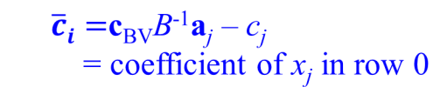
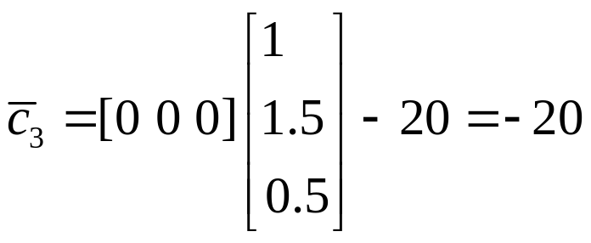
For each non-basic variable {x₁, x₂, x₃}, we have:
x₁ should enter the basis

Slide 20
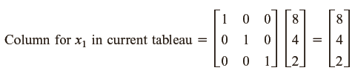

Which variable (s₁, s₂, or s₃) should leave the basis?
We compute the column for x₁ in the current tableau and the right-hand side of the current tableau:
Thus, the new tableau (tableau 1) will have BV(1) = {s₁, s₂, x₁}
and NBV(1) = {s₃, x₂, x₃}

Slide 21
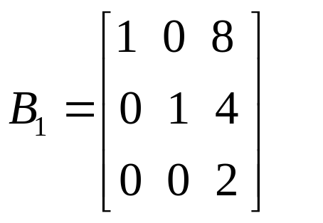
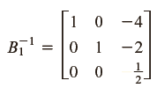


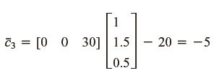

Thus, we enter x₃ into the basis.

Slide 22



BV(2)={s₁, x₃, x₁} and NBV(2) = {s₂, s₃, x₂}

Slide 23


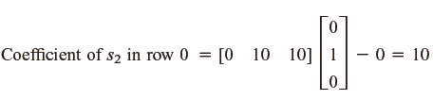

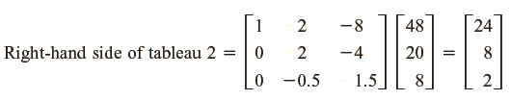

Slide 24
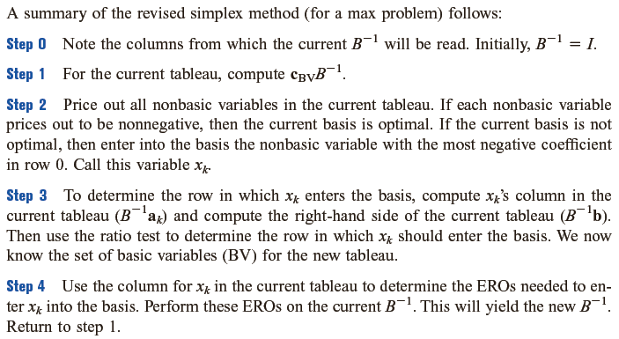
Summary

Slide 25
Most linear programming computer codes use some version of the revised simplex to solve LPs.
Knowing the current tableau’s B⁻¹ and the initial tableau is all that is needed to obtain the next tableau.
The computational effort required to solve an LP by the revised simplex depends primarily on the size of B⁻¹.

Slide 26

The Product Form of the Inverse
Much of the computation in the revised simplex algorithm is concerned with updating B⁻¹ from one tableau to the next.
Suppose we are solving an LP with m constraints.
Assume that we have found that x_{k} should enter the basis, in row r. Let the column for x_{k} in the current tableau be

Slide 27
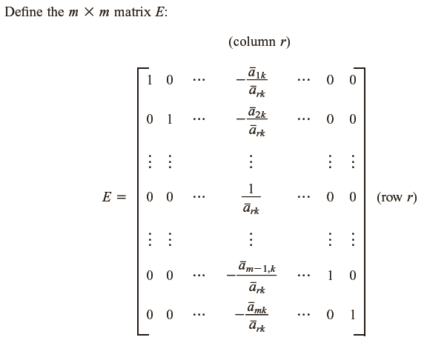

Slide 28
Define the initial tableau to be tableau 0, and let E_{i} be the matrix associated with the i-th simplex tableau.
B₀⁻¹ = I_{m}
B₁⁻¹ = E₀B₀⁻¹ = E₀
B₂⁻¹ = E₁B₁⁻¹ = E₁E₀
In general, B_{k}⁻¹ = E_{k-1}E_{k-2}…E₁E₀

Slide 29

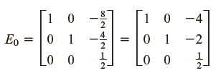
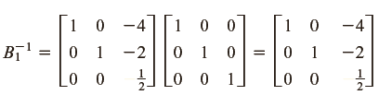
Example
Recall that in tableau 0, x₁ entered the basis in row 3.
Thus, for tableau 0, r =3 and k =1.
BV(0)={s₁, s₂,s₃}
BV(1)={s₁, s₂, x₁}

Slide 30

As we proceeded from tableau 1 to tableau 2, x₃ entered the basis in row 2.
Hence, in computing E₁, we set r=2 and k=3.
To compute E₁, we need to find the column for the entering variable (x₃) in tableau:

Slide 31


As before, x₃ enters the basis in row 2. Then

Slide 32
Column Generation
Gilmore and Gomory (1961)

Slide 33
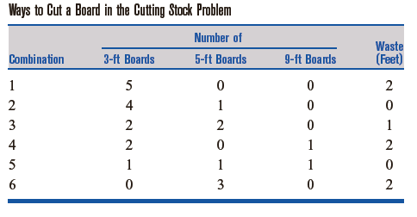
Column Generation
Cutting Stock Problem
  Woodco sells 3-ft, 5-ft, and 9-ft pieces of lumber.
  Woodco’s customers demand 25 3-ft boards, 20 5-ft boards, and 15 9-ft boards.
  Woodco, who must meet its demands by cutting up 17-ft boards, wants to minimize the waste incurred.
  Formulate an LP to help Woodco accomplish its goal, and solve the LP by column generation.

Slide 34
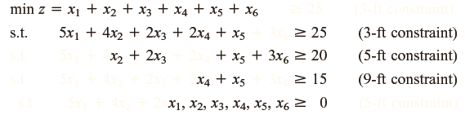
Define: x_{i} = number of 17-ft boards cut according to combination i.
Minimize the waste incurred = minimize the total number of 17-ft boards that are cut.
Constraint 1: at least 25 3-ft boards must be cut
Constraint 2: at least 20 5-ft boards must be cut
Constraint 3: at least 15 9-ft boards must be cut

Slide 35
The coefficient of x_{i} in the constraint for k-ft boards is just the number of k-ft boards yielded if a board is cut according to combination i.

Slide 36
It is clear that the x_{i} should be required to assume integer values.
In problems with large demand, a near-optimal solution can be obtained by solving the cutting stock problem as an LP and then rounding all fractional variables upward.
The above procedure may not yield the best possible integer solution, but it usually yields a near optimal integer solution.

Slide 37
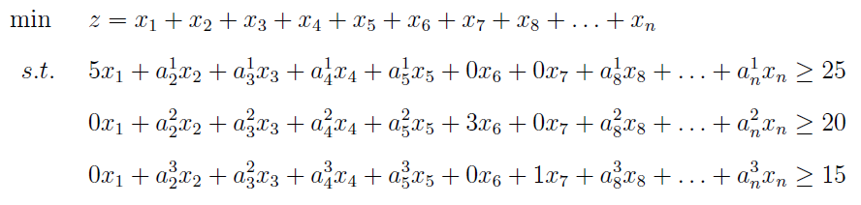
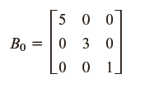
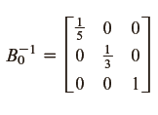

Basic variables (BV) x_{BV}= {x₁, x₆, x₇}
We let the tableau for this basis be tableau 0, then we have:
Shadow price

Slide 38
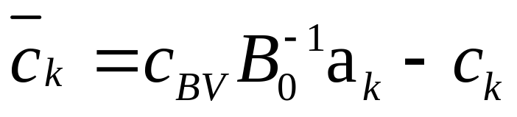
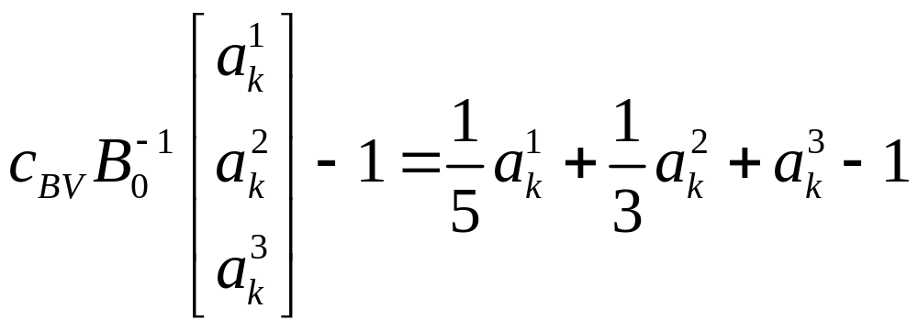
x_{BV} = B₀⁻¹b
a_{k} = (a¹_{k}, a²_{k}, a³_{k})^{T}
Reduced cost
for each k
Optimal conditions: all reduced costs are non-positive (最小化问题).

Slide 39
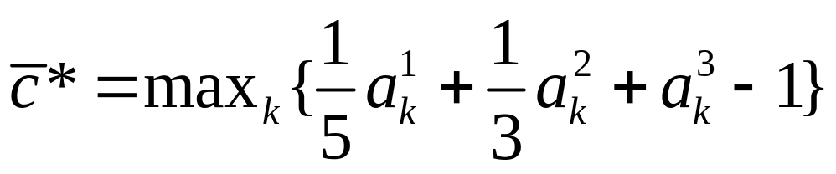
We need to find the a_{k} with maximum reduced cost, that is:
If the maximum reduced cost is non-positive, then the current solution is optimal.
a_{k}¹, a_{k}², a_{k}³ must be chosen so they don’t use more than 17 ft of wood.
We also know that a_{k}¹, a_{k}², a_{k}³ must be non-negative integers.
For any combination, a_{k}¹, a_{k}² and a_{k}³ must satisfy:
3a_{k}¹ + 5a_{k}² + 9a_{k}³≤17 (a_{k}¹≥0, a_{k}²≥0, a_{k}³≥0 and integer)

Slide 40
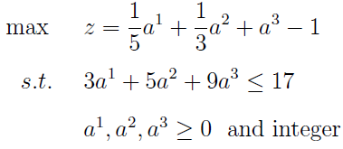
We can find the column a_{k} with maximum reduced cost by the following knapsack problem:
Note that a¹, a², a³ now are decision variables in this problem.
That is, we use this knapsack problem to check
the reduced cost of all columns a_{k}.
The solution of this knapsack problem must correspond to a column.

Slide 41
Optimal Solution: z=8/15≥0, (a₁, a₂, a₃)^{T}= (1, 1, 1)^{T}

Slide 42
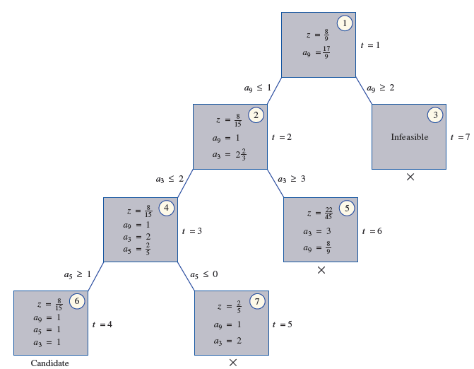

Slide 43
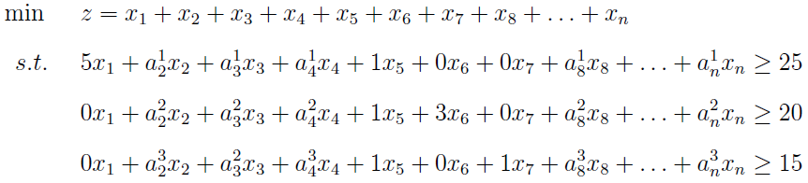

Slide 44
We assume the optimal solution of the knapsack problem corresponds to the fifth column.
Will enter into the basis.

Slide 45

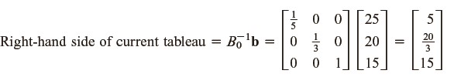
Which variable should leave the basis?

Slide 46
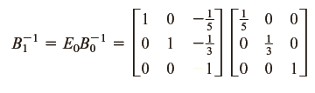
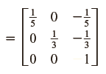

The new basic variables are {x₁, x₆, x₅}

Slide 47
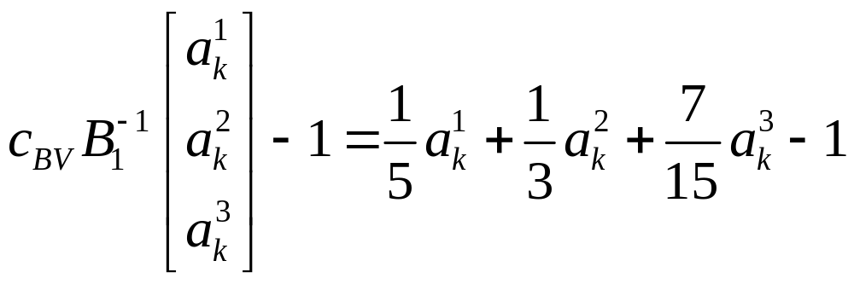
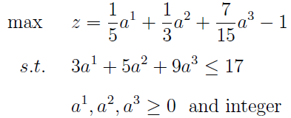
For the current tableau, the column generation procedure yields
The following problem:
Optimal solution 2/15 and (a₁, a₂, a₃)= (4, 1, 0)

Slide 48
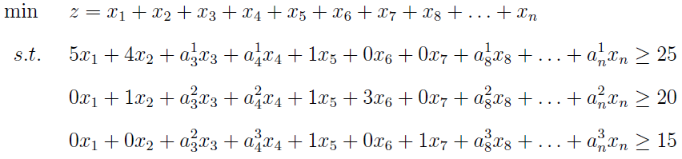
We assume the optimal solution of the knapsack problem corresponds to the second column.
Will enter into the basis.

Slide 49
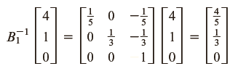

The column for x₂ in the current tableau is:
The right-hand side of the current tableau is:
Which variable should leave the basis?

Slide 50
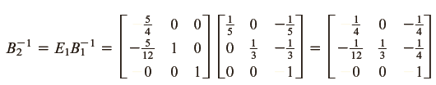
The new basic variables are {x₂, x₆, x₅}

Slide 51
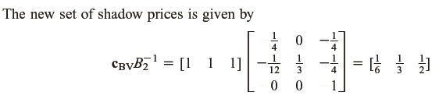
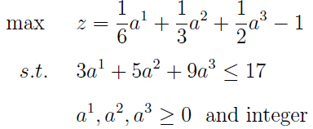
Thus, the column-generation procedure requires us to solve
the following problem:
The optimal z-value for the above model is found to be z=0.

Slide 52
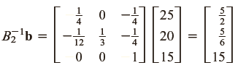
The optimal z-value for the above model is found to be z=0.
  The current basic solution must be an optimal solution.
  To find the values of the basic variables in the optimal solution, we find the right-hand side of the current tableau:
  Thus, x₂ = 5/2, x₆ = 5/6 and x₅=15 is the optimal solution to Woodco’s cutting stock problem (relaxed version).

Slide 53
Column Generation
We need not list all possible ways in which a board may be cut.
At each iteration, a good combination (one that will improve the z-value when entered into the basis) is generated by solving a branch-and-bound problem.
The fact that we don’t have to list all the ways a board can be cut is very helpful.
A cutting stock problem that was solved in Gilmore and Gomory (1961) involves more than 100 million possible combinations.

